Slide 1

ECE 2700
Digital Circuits
Welcome!

Slide 2
Instructor & Contact Info
Dr. Tam Chantem
  EL 176
  tam.chantem@usu.edu
Office Hours
  TBD

Slide 3
Course Info
Lectures (ENGR 302)
  MWF 9:30 am – 10:20 am
Labs (EL 120)
  W 3:00 pm - 5:50 pm
  T, R 7:30 am - 10:15 am
  T, R 10:30 am - 1:15 pm
  T, R 1:30 pm - 4:15 pm
Prerequisite
  CS 1400 Introduction to Computer Science – CS1

Slide 4
Teaching Assistants
Francisco Arrieta
  francisco.arrieta@aggiemail.usu.edu
Jeffrey Michaelis,
  jeffrey.michaelis@aggiemail.usu.edu
Madi Mickelsen
  madi.mickelsen@aggiemail.usu.edu
William Shipley
  willrandship@gmail.com
Sam Tanner
  sam.tanner@aggiemail.usu.edu
Taylor Warner
  taylor.warner@aggiemail.usu.edu
Michael Welch
  michael.welch@aggiemail.usu.edu

Slide 5
Homework Grader / Tutor
Atif Yasin
  atifyasin2@gmail.com
Tutor
  ENGR 322 and ENGR 324
  Mondays, Wednesdays, and Fridays
    8:00am—5:00pm
  Tuesdays and Thursdays
    8:00am—7:00pm

Slide 6
Course Website
Canvas (canvas.usu.edu)
  Complete syllabus
  Important announcements
  Lecture notes
  Homework assignments
  Labs
  Etc…

Slide 7
Course Description
This course will teach you about
  Boolean logic and algebra
  Combinational and sequential circuits
  Finite and high-level state machines
  Datapath components
It will also introduce you to
  Digital system design
  Modeling, simulation, implementation, and verification

Slide 8
Course Objectives
At the end of the course, you will be able to
  Learn fundamental principles, generalizations, or theories
  Gain factual knowledge
  Learn to apply course materials

Slide 9
Textbooks & Resources
Textbooks
  Digital Design with RTL Design, VHDL, and Verilog (Second Edition) by Frank Vahid
  Verilog for Digital Design by Frank Vahid and Roman Lysecky
Reference texts
  3 placed under course reserves in the library
  See syllabus for details
Additional resources on website

Slide 10
Lectures
You are expected to read relevant sections of textbooks prior to lectures
Lectures will cover
  The most important and difficult parts of the course material
  Overview of labs
  Homework-related questions (and answers)

Slide 11
i>clicker
Required classroom response system
  i>clicker Go OK
Bring to every lecture
Register your clicker before class on Friday
  http://www.iclicker.com/support/registeryourclicker/

Slide 12
Daily Quizzes
Open book, open notes, closed neighbor
Each quiz
  3 points for answering
  7 points for correct answer
Cannot be made up
Drop 3 lowest quizzes

Slide 13
Exams
Three exams
Exams cover specified reading and lecture material
  Study guides will be provided
Calculator and one 8.5” x 11” cheat sheet allowed
  1 per exam (double sided)

Slide 14
Homework
Weekly assignments (Wednesdays)
Due at beginning of class
Must follow required homework format
  Or it will not be accepted
Show your work!
Late homework not accepted

Slide 15
Labs
6 labs and one design project
First lab will take place next week
Some labs will require preparation in advance
  Follow required homework format
  10% penalty if not completed prior to start of lab
Late lab policy
  10% penalty each week
  Accepted up to two week after due date
You must perform work on all the labs and design project to pass the class

Slide 16
Lab Equipement
Software
  Xilinx ISE
  Available in EL 101, EL 105, and EL 120
    Get key card for after hours / weekend access
  Free version available (Windows and Linux)
Hardware
  Basys FPGA board or Basys 2 FPGA board
  Check one out from ECE store (EL 104A) before first lab session (next week)

Slide 17
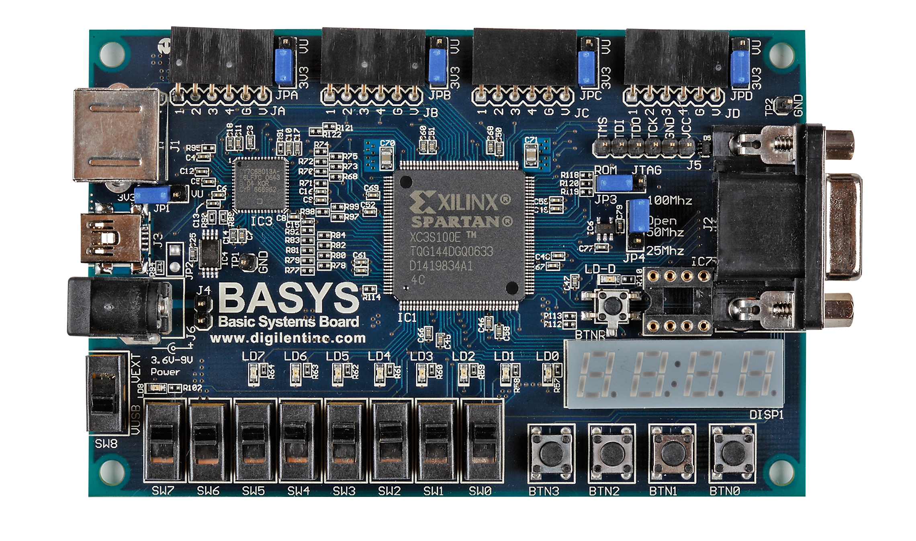
Basys Board

Slide 18
Grade Breakdown
Assignments 15%
Labs 30%
First Exam 15%
Second Exam 15%
Third Exam 15%
Daily quizzes 10%

Slide 19
Grading Scale
93–100 A
90–92 A-
87–89 B+
83–86 B
80–82 B-
77–79 C+
73–76 C
70–72 C-
67–69 D+
63–66 D
60–62 D-
0–59 F

Slide 20
Re-Grading Policy
Must be made within one weeks after they are handed back
You should try to resolve any issues with the TA or grader first

Slide 21
Academic Integrity
Collaboration and study groups encouraged
What’s not OK?
  Copying someone else’s assignment or code, or allowing another student to copy yours
  Having another student use your i>clicker if you miss class
  Using material from previous years’ classes
  Using the instructor’s solution manual for this class’s textbooks
  Searching for homework answers on the Internet
Appropriate action will be taken…

Slide 22
Accommodations
If you have a disability, please contact
  Disability Resource Center (DRC)
  Room 101 of the University Inn
  (435)797-2444 voice
  (435)797-0740 TTY
  (435)797-2444 VP
  Toll free at 1-800-259-2966.

Slide 23
Course Schedule & Readings
Refer to syllabus
Continuously updated on course website

Slide 24
Now Help Me!
On an piece of paper, write down
  Your name
  Why you want to be an engineer
    (Other than the fact that it’s an awesome thing to be)
  Something interesting about you
  Preferred office hours (give several!)

Slide 25
Why Digital Design?

Slide 26
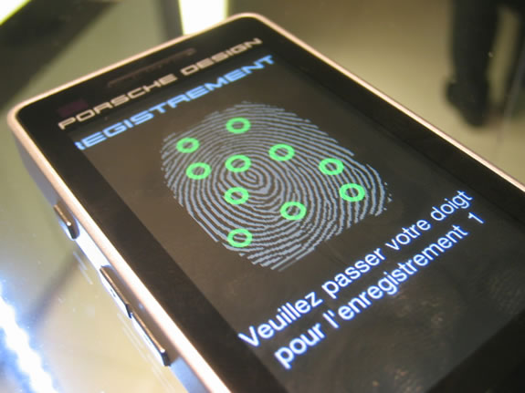
Fingerprint Identifier
http://www.slashphone.com/sagem-porsche-design-p9522-goes-full-touch-screen-292238

Slide 27

Roomba
http://www.techeblog.com/index.php/tech-gadget/feature-top-5-roomba-hacks

Slide 28
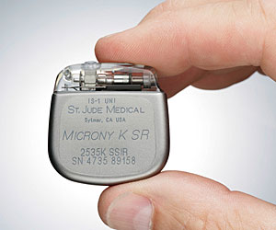
Pacemaker
http://www.pbs.org/wnet/heart/episode2/anatomy.html

Slide 29
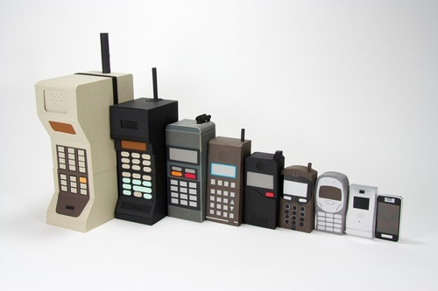
Cell Phone Evolution
http://abll.info/2009/12/07/the-ever-shrinking-cellphone-matryoshka-timeline-cellphones/
Notes:
We can do more things as technology scales & become cheaper
Work with people in other fields

Slide 30

But The Most Impressive Thing Is…

Slide 31
TODO
Register your i>clicker by Friday
Check out a Basys board from EL 104A by next Wednesday

